Slide 1

INT247 Machine Learning Foundations
Lecture #4.0
Data Pre-processing

Slide 2
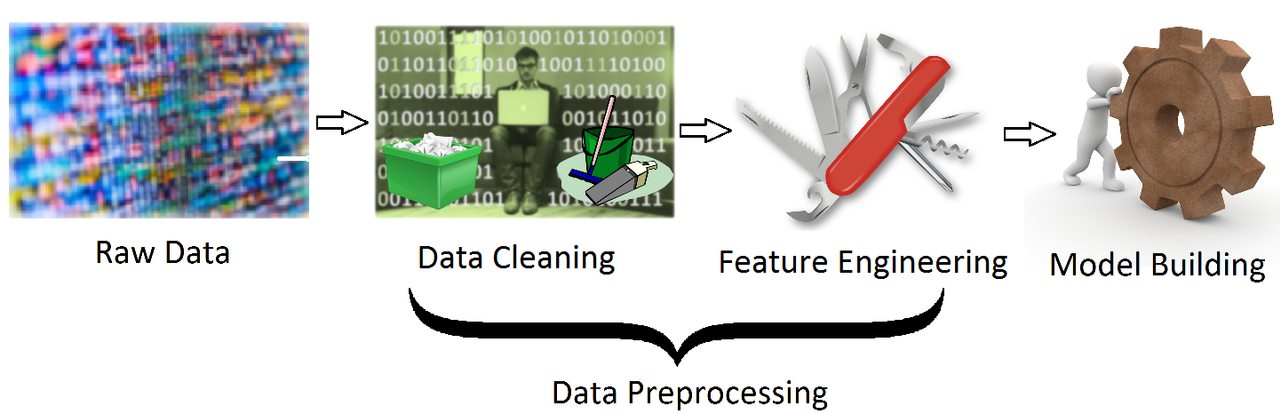
Data
Machine learning depends largely on test data.
A large amount of data is required for ML.

Slide 3
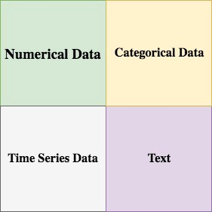
Different types of data in ML
Data can be categorized into 4 basic types:
Numerical Data
Categorical Data
Time Series Data
Text

Slide 4
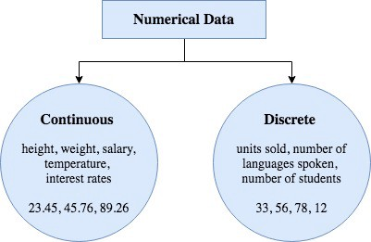
Numerical Data

Slide 5
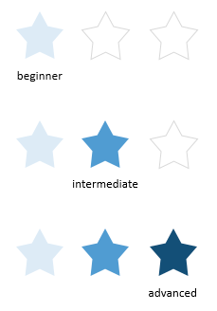

Categorical Data
Ordinal Data

Slide 6
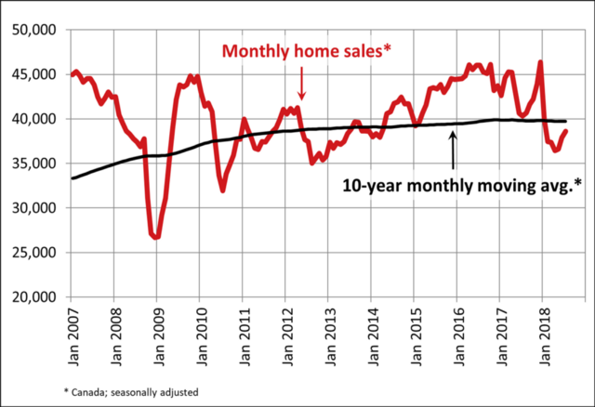
Time-Series Data

Slide 7

Text Data

Slide 8

Data Preparation Process
The process of data preparation comprises the following:
Data Selection
Data Pre-processing
Data Transformation

Slide 9
Data Selection
Steps involved in Data Selection involves:
Selecting only a subset of available data.
The selected sample must be an accurate representation of the entire population.
Some data can be derived or simulated from the available data if required.
Data not relevant to the problem at hand can be excluded.

Slide 10
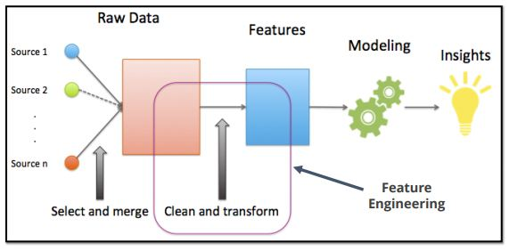
Feature Engineering
Transforming raw data into features that better represent the underlying problem to the predictive models, resulting in improved model accuracy on unseen data.

Slide 11
Framework of Feature Engineering
Frame your problem:
Can you frame your problem in a way that machine learning could be useful. Eg: prediction.
Understand your data:
What data will be most helpful to understand and generate a better understanding of the problem.
Frame your feature goals:
What are you optimizing for?
Iteration speed
Model performance
Test, Iterate, Test Again:
Check your choices for robustness.
Validate

Slide 12
Aspects of Feature Engineering
Feature Selection
Feature Extraction
Feature Addition
Feature Filtering

Slide 13
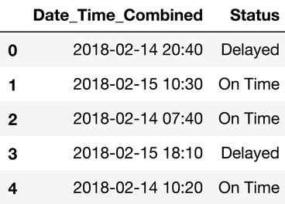
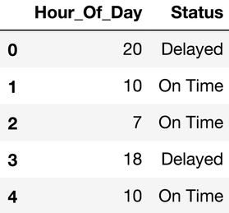
Example: flight date time vs status
Status of flight depends on the hour of the day, not on the date-time.
Creating new feature “Hour_of_Day” is the feature engineering.

Slide 14
Feature Selection vs Feature Extraction vs Feature Engineering
Feature selection is essential for creating the dataset.
Feature extraction applies automatic methods like PCA for constructing new features.
Feature engineering deals with the manual construction of features from raw data.

Slide 15


